Slide 1
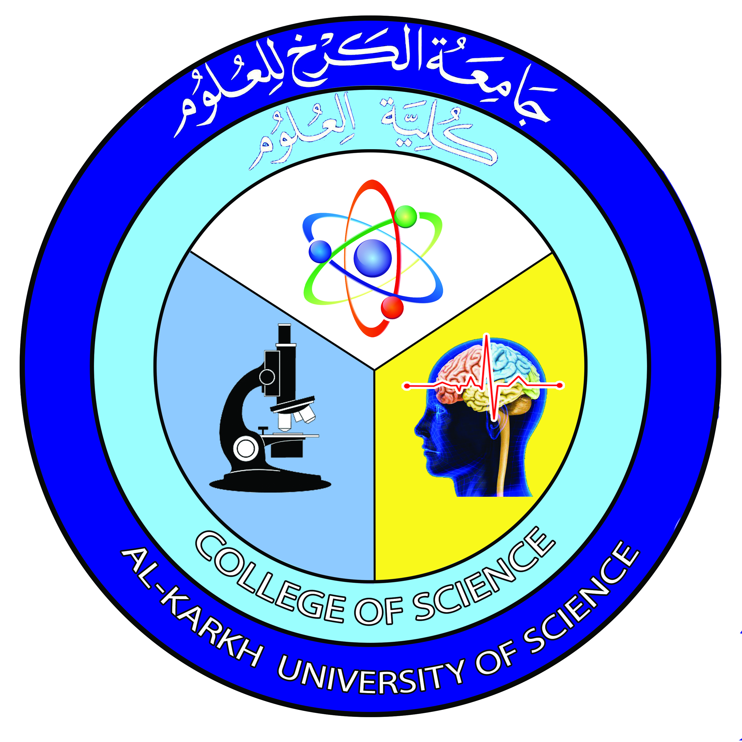

General Microbiology
Lecture 1
Prof. Dr. Munira Ch. Ismaeel
Ass. Prof. Dr. Israa AJ Ibrahim

Slide 2
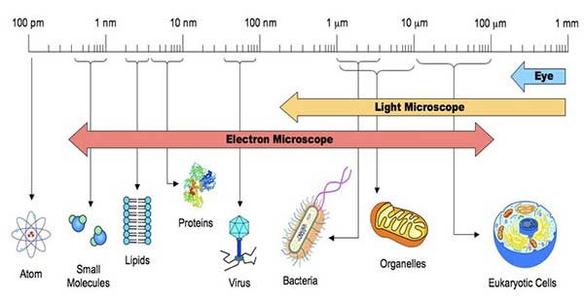
General Microbiology
Prof. Dr. Munira Ch. Ismaeel and Ass. Prof. Dr. Israa AJ Ibrahim

Slide 3
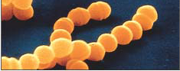
Microbiology Lec.1
Is a science that deals with the study of living organisms that cannot be seen by the naked eye. These can be seen with the aid of microscopes, which magnify the objects.
Or The branch of biology dealing with the structure, function, uses, and modes of existence of microscopic organisms.
There are five major groups of microorganisms: bacteria, algae, fungi, protozoa, and viruses.

Slide 4
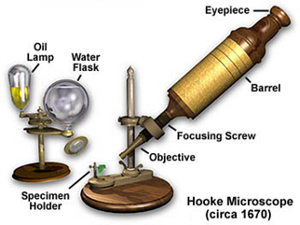
The Discovery of Microorganisms
Two remarkable geniuses, Robert Hooke and Antonie van Leeuwenhoek, deserve the credit for discovering microorganisms in the 17th century.
Robert Hooke (1635 – 1703) was an English natural philosopher, architect and polymath. Hooke illustrated the microscope in his Micrographia, one of the first detailed treatises on microscopy and imaging

Slide 5
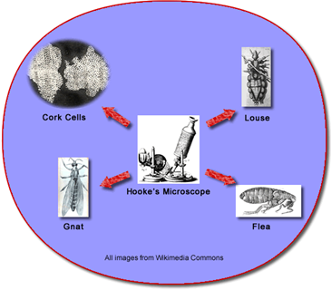
Micro.
Robert Hooke's sketches of a flea, louse, and a gnat appeared in the book Micrographia, which was published in 1665. He coined the term "cell" for a honeycomb-like structure in a cork slice using a primitive compound microscope.

Slide 6
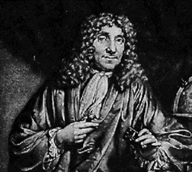
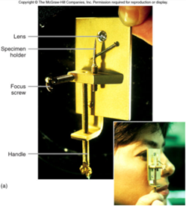
Micro.- Antony van Leeuwenhoek
Antony van Leeuwenhoek (1632-1723) was a Dutch businessman, scientist, and one of the notable representatives of the Golden Age of Dutch science and technology constructed microscopes ( simple microscope) and was the first person to observe and describe microorganisms accurately. Leeuwenhoek observed and described microscopic protozoa and bacteria. He is commonly known as "the Father of Microbiology”.

Slide 7
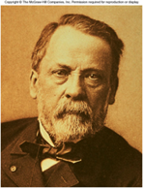
Micro.
Edward Jenner (1749 – 1823) was an English physician and scientist who was the pioneer of smallpox vaccine, the world's first vaccine.
Louis Pasteur (1822-1895)
was a French biologist, microbiologist and chemist famous for his discoveries of the principles of vaccination, microbial fermentation and pasteurization. Used cotton plugs in his cultures to prevent air borne contamination, devised Aseptic Technique. He created the first vaccines for rabies and anthrax. Pasteur was responsible for disproving the doctrine of spontaneous generation. He performed experiments that showed that without contamination, microorganisms could not develop.

Slide 8
Robert Koch - Micro.
Robert Koch (1843-1910) (was a celebrated German physician and pioneering microbiologist), using criteria developed by his teacher, Jacob Henle (1809-1895), discovered the causative agent of anthrax, it is Bacillus anthracis ; his criteria became known as Koch's Postulates and are still used to establish the link between a particular microorganism and a particular disease:
a-The microorganisms must be present in every case of the disease but absent from healthy individuals.
b-The suspected microorganisms must be isolated and grown in pure culture.
c-The same disease must result when the isolated microorganism is inoculated into a healthy host.
d-The same microorganism must be isolated again from the diseased host.

Slide 9
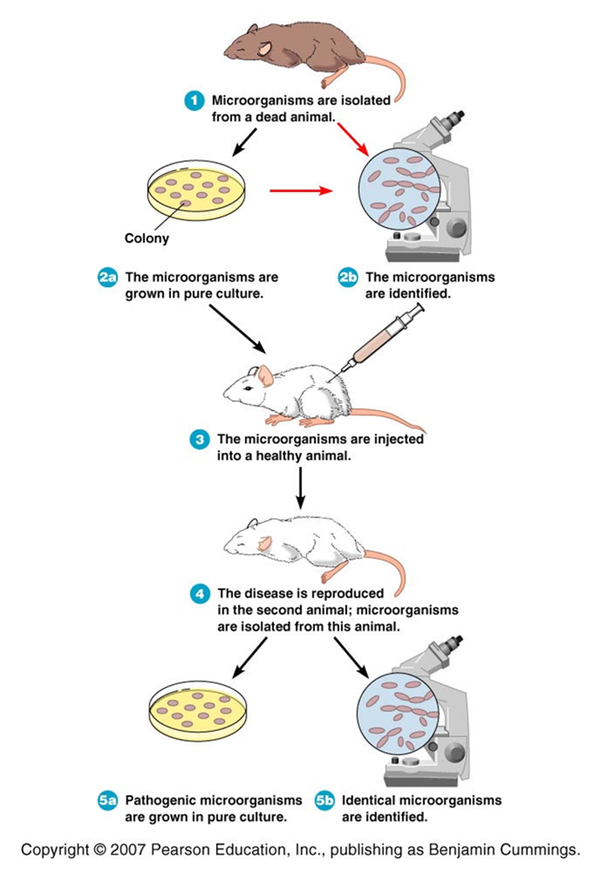
Micro. - Koch's Postulates

Slide 10
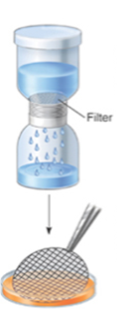
Micro.
Koch and his associates developed techniques, reagents, and other materials for culturing bacterial pathogens on solid growth media; these enable microbiologists to isolate microbes in pure culture.
John Tyndall (1820-1893) was a Irish physicist. Demonstrated that dust did carry microbes and that if dust was absent, the broth remained sterile-even if it was directly exposed to air; Tyndall also provided evidence for the existence of heat-resistant forms of bacteria.
Charles Chamberland (1851-1908) was a French microbiologist constructed a bacterial filter (Chamberland filter or Chamberland-Pasteur filter) that removed bacteria and larger microbes from specimens; this led to the discovery of viruses as disease-causing agents.

Slide 11
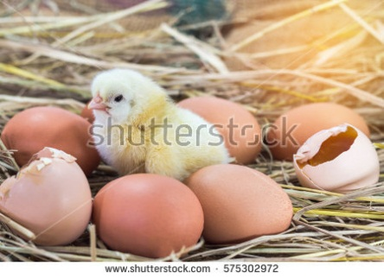
Spontaneous Generation
Abiogenesis vs. Biogenesis
-“Spontaneous Generation” was an early belief that living things can arise from vital forces present in nonliving and decaying matter (Ex: maggots from meat) (Abiogenesis).
-The alternative hypothesis that living organisms can arise only from preexisting life forms is called (Biogenesis).

Slide 12
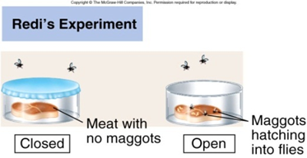
Micro.
Francisco Redi (1626–1697) was an Italian physician, naturalist, biologist and poet. He was the first person to challenge the theory of spontaneous generation by demonstrating that maggots come from eggs of flies

Slide 13
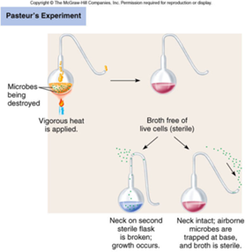
Micro.
Louis Pasteur put an end to Abiogenesis debate with his Swan Neck Flask Experiment:
The swan neck flask experiment. Pasteur filled a flask with medium, heated it to kill all life, and then drew out the neck of the flask into a long S shape. This prevented microorganisms in the air from easily entering the flask, yet allowed some air interchange. If the swan neck was broken, microbes readily entered the flask and grew.

Slide 14
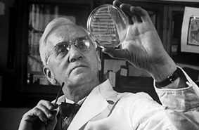
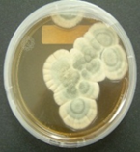
Micro.
Alexander Fleming(1928) was Scottish physician and bacteriologist. Observed mold growing on a bacteria culture, there was a ring of clearing around the mold where the bacteria didn’t grow, the mold was later found to be a Penicillium species and the naturally secreted chemical was called penicillin, an antibiotic.

Slide 15
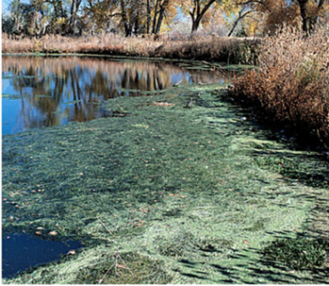
The Scope and Relevance of Microbiology
Microorganisms live almost everywhere on earth where there is liquid water or even a tiny amount of moisture, including hot springs on the ocean floor, deep inside rocks within the earth's crust, on the human skin, in a cow's stomach, and inside a sponge used for washing dishes. Many microorganisms are critical to nutrient recycling in ecosystems as they act as decomposers, while others living in nodules on the roots of some plants convert nitrogen from the air to a form usable by plants.
Ex: Photosynthetic Microbes

Slide 16
Branches of Microbiology
The branches of microbiology can be classified into pure and applied sciences.
Pure microbiology (fundamental branch) in this field the organisms are studied as the subject itself on a deeper level.
• Bacteriology: the study of bacteria.
• Mycology: the study of fungi.
• Protozoology: the study of protozoa.
• Phycology/algology: the study of algae.
• Parasitology: the study of parasites.
• Immunology: the study of the immune system.
• Virology: the study of viruses.
• Nematology: the study of nematodes.

Slide 17
•Microbial cytology: the study of microscopic and submicroscopic details of microorganisms.
•Microbial physiology: the study of how the microbial cell functions biochemically. Includes the study of microbial growth, microbial metabolism and microbial cell structure.
•Microbial ecology: the relationship between microorganisms and their environment.
•Microbial genetics: the study of how genes are organized and regulated in microbes in relation to their cellular functions. Closely related to the field of molecular biology.
•Cellular microbiology: a discipline bridging microbiology and cell biology
•Evolutionary microbiology: the study of the evolution of microbes. This field can be subdivided into:
•Microbial taxonomy: the naming and classification of microorganisms.
•Microbial systematic: the study of the diversity and genetic relationship of microorganisms.
•Generation microbiology: the study of those microorganisms that have the same characters as their parents.
•Systems microbiology: a discipline bridging systems biology and microbiology.
•Molecular microbiology: the study of the molecular principles of the physiological processes in microorganisms.

Slide 18
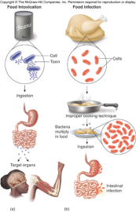
Applied microbiology
Applied microbiology refers to the fields where the micro-organisms are applied in certain processes. The organisms itself are often not studied as such, but applied to sustainالمحافظة certain processes.
•Medical microbiology: the study of the pathogenic microbes and the role of microbes in human illness. Includes the study of microbial pathogenesis and epidemiology and is related to the study of disease pathology and immunology. This area of microbiology also covers the study of human microbiota, cancer, and the tumor microenvironment.
•Pharmaceutical microbiology: the study of microorganisms that are related to the production of antibiotics, enzymes, vitamins, vaccines, and other pharmaceutical products and that cause pharmaceutical contamination and spoil.
•Industrial microbiology: the exploitation of microbes for use in industrial processes. Examples include industrial fermentation and wastewater treatment. Closely linked to the biotechnology industry. This field also includes brewing, an important application of microbiology.

Slide 19
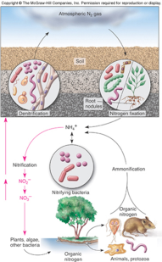
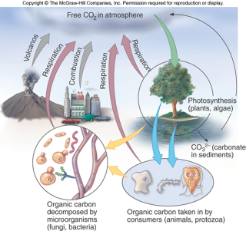
Micro.
•Microbial biotechnology: the manipulation of microorganisms at the genetic and molecular level to generate useful products.
•Food microbiology: the study of microorganisms causing food spoilage and foodborne illness. Using microorganisms to produce foods, for example by fermentation.
•Agricultural microbiology: the study of agriculturally relevant microorganisms. This field can be further classified into the following:
•Plant microbiology and Plant pathology: The study of the interactions between microorganisms and plants and plant pathogens.
•Soil microbiology: the study of those microorganisms that are found in soil.
•Veterinary microbiology: the study of the role of microbes in veterinary medicine or animal taxonomy.
•Environmental microbiology: the study of the function and diversity of microbes in their natural environments. This involves the characterization of key bacterial habitats such as: the rhizosphere and phyllosphere, soil and groundwaterecosystems, open oceans or extreme environments. This field includes other branches of microbiology such as:
•Microbial ecology
•Microbially mediated nutrient cycling
•Geomicrobiology
•Microbial diversity
•Bioremediation: use of micro-organisms to clean air, water and soils.
•Water microbiology (or aquatic microbiology): The study of those microorganisms that are found in water.
•Aeromicrobiology (or air microbiology): The study of airborne microorganisms.
•Biotechnology: related to recombinant DNA technology or genetic engineering

Slide 20
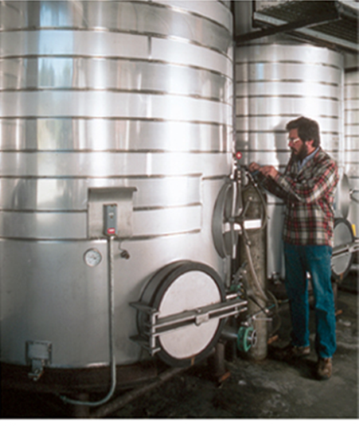
Careersالوظائف in Microbiology
Microbiologists work mainly in the Medical and Clinical Laboratories, and also in industries (pharmaceutical companies, agricultural biotechnology companies, food companies, sewage companies).
In addition the Microbiologists can work as Epidemiologists, Technologists and Technicians, Natural Sciences Managers, secondary Teachers, Zoologists and Wildlife Biologists.

